Slide 1

TCOTC 2026
Annual Membership Meeting
January 13, 2026

Slide 2
Agenda
WELCOME
Introduction to TCOTC - Executive Director Anne Schenk
Introduction of current Board Members - Board President Julie Steenerson
Approval of Minutes of January 14, 2025 Annual Membership Meeting
Board Nominations – Anne Schenk
Introduction of Nominees
OFFICER AND TEAM REPORTS
President Report - Julie Steenerson
Executive Director Report - Anne Schenk
Membership Coordinator Report - Corrie Barrows
Events Coordinator Report - Scott McKenzie
Agility Report - Lisa Nawrocki
Camp K9 Report - Meg Beisner
Conformation Report - Wendy Olson
Flyball and Tracking Reports - Anne Schenk
Obedience Report - Jane Jacobson
Therapy Program Report - Carol Ouhl
Flyball Team Report - Karen Radford

Slide 3
Agenda
cont’d
COMMITTEE REPORTS
TCOTC Building Committee - Karen Radford
TCOTC Lease Negotiation Task Force - Maddie O’Rourke
TCOTC Safety Committee - Joyce Carlson-Rioux
TCOTC Finance Committee - Karen Radford
ANNOUNCEMENT OF NEW BOARD MEMBERS
ANNOUNCEMENT OF AWARDS
2025 Volunteer of the Year
TCOTC Call to Action - Julie Steenerson
ADJOURN
Please Note:
• Only members who are current with their membership dues are eligible to vote at this meeting.
• After the nominating committee makes nominations, nominations will be opened to the floor. At this time any member in good standing (as defined in the by-laws) may nominate any other member in good standing as long as they have consent from the nominees to do so. If any member so nominated is not present at the meeting, their consent must be in writing and presented to the recording secretary at the time of nomination.
• All committee reports should be limited to ten minutes in length. This includes discussion of the report. Individual comments will be limited to two minutes per person for each topic.

Slide 4

President Report
Julie Steenerson
The Board meeting cadence of six meetings over the course of the year kept our Board of 7 Directors well connected to achieve steady results. We focused on managing TCOTC expenses in the first half of the year via committee and task force work, and in the second half, we were able to shift our focus to increasing revenue for the Club and engaging TCOTC members.
Jan Wagner, a new member in 2025, quickly became integrated into multiple initiatives providing sound direction and legal guidance.
Joyce Carlson-Rioux continued serving as Recording Secretary in the final year of her term - she is a valuable source for governance and exemplifies optimism in her approach. She will continue to lead the Safety Committee.
June Mendoza, Corresponding Secretary, extended her involvement from the Building Committee to the Lease Negotiation Task Force providing analytical expertise. She has ended her term and we will miss her dynamic energy.
Treasurer Maddie O’Rourke spearheaded the Lease Negotiation Task Force navigating a multi-pronged process that improved and solidified the Club’s location. She has ended her term as well but we will find her smiling enthusiasm as classmates and at member events.
Vice President Liz Danielson showcased her financial savvy in both Board and committee meetings.
Diane Steele shared social media ideas and looks forward to deepening her input in 2026.

Slide 5
President Report
cont’d
Julie Steenerson
TCOTC Team Leaders Jane Jacobson for Obedience, and Lisa Nawrocki for Agility shared expert perspective with the Board on behalf of their teams of instructors and assistants. From team and class participant feedback, they generated ideas for improving curriculum and expanding class offerings to appeal to member needs.
TCOTC Financial Leader Mary Steinbauer provided financial reports and historical data to inform critical decisions of the Finance Committee and the Board of Directors, as a whole.
Karen Radford’s spirit of volunteerism shined bright as chairperson of the Finance Committee, the Building Committee, and Flyball Team. She is a valued Board advisor and her contributions are instrumental to the legacy of TCOTC and its continuous improvement.
Executive Director Anne Schenk is omnipresent at TCOTC touching every aspect of the Club and every member through her beautifully written newsletters. She embodies the TCOTC Vision of building positive human and dog partnerships.
I am honored to have served as Board President in 2025 and I am excited about the addition of new 2026 Directors to continue growing TCOTC and broadening opportunities for membership engagement.

Slide 6
Approval of 2025 Minutes
TCOTC Annual Membership Meeting Minutes: January 14, 2025
Welcome
Meeting began at 7:05 pm.
Introduction to TCOTC - Executive Director Anne Schenk
Anne welcomed members in attendance (both online and in-person)
Introduction of current Board Members - Board President Julie Steenerson
Julie introduced board members who served in 2024 and announced opening for one new member who will serve from 2025 – 2028.
Approval of Minutes of January 9, 2024 Annual Membership Meeting
Jim Walsh moves to accept the January 8, 2024 Annual Membership Meeting Minutes, June Mendoza seconds the motion
The motion is approved unanimously.
Board Nominations – Anne Schenk
Jan Wagner was nominated for the 2025-8 board term
No additional nominations were made from the floor
Introduction of Candidates
Anne shared information about Jan Wagner’s involvement at TCOTC with her pug, Dobby. They are flyball participants. Jan has donated her time painting canine portraits to the annual flyball raffle. Jan has a background in nonprofit law.
Jim Walsh moves to nominate Jan for the board position, Annette Lundberg seconds the motion.

Slide 7
2025 Minutes cont’d
Officer and Team Reports
Officer and Team Reports are available in the attached Power Point Presentation. Questions from members in attendance were taken.
President Report - Julie Steenerson
Executive Director Report - Anne Schenk
Membership Coordinator Report - Corrie Barrows
Events Coordinator Report - Scott McKenzie
Agility Report - Lisa Nawrocki
Camp K9 Report - Anne Schenk
Conformation Report - Anne Schenk
Flyball and Tracking Reports - Anne Schenk
Obedience Report - Jane Jacobson
Therapy Program Report - Carol Ouhl
Flyball Team Report - Karen Radford
Committee Reports
Committee Reports are available in the attached Power Point Presentation. Questions from members in attendance were taken.
TCOTC Building Committee - Karen Radford
TCOTC Safety Committee - Joyce Carlson-Rioux
TCOTC Finance Committee - Karen Radford
TCOTC Call to Action - Julie Steenerson
Julie invited members to volunteer to help committees above. It would be especially helpful to have members familiar with marketing or lease negotiations willing to help at this time.

Slide 8
2025 Minutes cont’d
Announcement of New Board Member
New Board Member voting results
Jan Wagner is unanimously elected to the 3025-2028 board position.
Announcement of Awards
2024 Volunteer of the Year
Anne Schenk announced that Christina Wessel has been named 2024 Volunteer of the Year
2024 Spirit Award
Anne Schenk announced that Sara Brokaw has been named 2024 Dale Weyrich Spirit Award winner for her extensive efforts in building the scentwork program at TCOTC.
Adjourn
June Mendoza moves to adjourn at 7:56 pm.

Slide 9
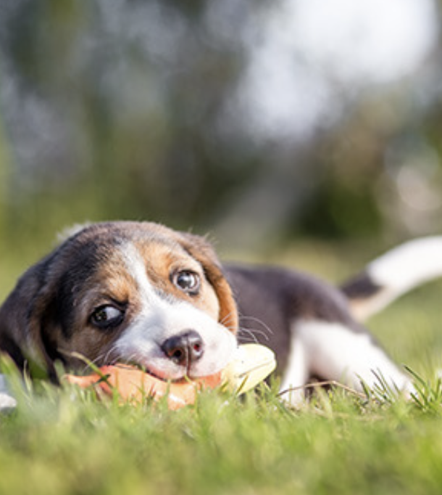
Board Nominations
Mission
To provide opportunities for the community to come together and enjoy a variety of positive and humane training, educational and social activities with their dogs.
Vision
Building positive human and dog partnerships.
Values
Community: We are a welcoming organization committed to building pawsitive relationships.
Fun: We encourage and incorporate fun in all activities.
Diversity: We respect and support diversity in people, dogs, ideas and activities.
Learning: We promote lifelong learning and excellence in education.
Leadership: We inspire leadership at every level of our organization.
Safety: We emphasize safety awareness and healthy lives.

Slide 10
Katie Bridges
I have been attending classes at TCOTC for almost three years. My dog Kevin and I have taken puppy classes, obedience classes, tried agility and tracking and found a love of scent work here at TCOTC.
Professionally, I work as an Institutional Review Board Analyst for the University of Minnesota. I review research studies that involve human participants to ensure regulatory compliance and ethical design. I hope to share my strategic thinking skills and creativity to help others find meaningful ways to bond and have fun with their dogs.
Brenda Vale
I have been a member of TCOTC for 5 years. I've participated in various TCOTC training programs and currently train my dog, Keva, in scent work and agility.
I have business experience with both international and domestic organizations, with expertise in a number of professional functions including Human Resources, Organizational Development, Recruiting, Executive and Board Compensation, Real Estate and Facilities Management, Sourcing and Procurement, Labor Relations and Contract Negotiations, Privacy and IT Security.
With a broad background and proven problem solving and organization skills, I would seek to help address the financial and educational challenges facing TCOTC as a nonprofit organization in a competitive environment.
We have a wonderful organization with deeply caring and committed individuals. I share their commitment and desire for a strong successful future ahead for TCOTC.

Slide 11
Jonah Hacker
I have been a member of TCOTC since January 2025. I train my sheltie, Leo, in agility two nights per week and we have been trialing regularly since joining TCOTC. We rescued another sheltie earlier this year and are planning to begin more training with her as she has grown more comfortable with us.
I have really appreciated the warm sense of community among club members and would love to contribute to this organization as a board member.
I have previously served four years as Treasurer of the Board for the Association for Experiential Education, a nonprofit membership organization. As treasurer, I worked with the Executive Director and other board members to implement strong financial controls within the organization, improved the investment strategy (which contributed to a six-fold increase in the organization's equity), and established an annual 5k run fundraising event.
In my time on the board, I also proved myself to be a steadfast board leader and supporter of the association as it navigated the COVID-19 pandemic, board resignations, and membership conflicts. I would bring the same commitment and level-headedness to the TCOTC board in service of the organization, the members, and their dogs.
I hold an MBA from the Carlson School of Management at the U of M and work as a product manager at a technology company. Thanks to my work, I bring a deep knowledge in how to engage people and improve their experience through technology. I would be honored to serve on the TCOTC board to further the mission and programs of this great organization.

Slide 12
Executive Director Report
Anne Schenk
In 2025 my work involved supporting the board of directors in negotiating a new lease with Capp Industries, our landlord. We successfully negotiated a favorable lease for a term of five years.
Like many clubs in the area, TCOTC saw reductions in enrollment due to economic pressures starting in the spring. I worked with the board and staff to create opportunities to generate additional revenue to offset declining enrollment. These efforts were largely successful and included:
Adding a new seminar presenter, Crystal Wing, for a weekend of obedience-oriented seminars that were very well received.
Offering “early bird” discounts to Basic and Puppy Basic Training students who enroll in a Tier 2 class before their Basic class ends. Thirty-eight members took advantage of this offer.
Offering a “State Fair Special” discount for attendees at our State Fair demonstrations on Tuesday, August 25. Eleven people registered for classes using the discount, with more than half of them being new members.
Adding events, special classes, mini-seminars and instructed open ring sessions. I especially want to thank Scott McKenzie, Chris Schultz, Anitra Francis, Laura Breckheimer, Sara Brokaw, Meg Beisner, Corrie Barrows, Laura Waudby, Jane Jacobson, Jan Wagner, Julie Steenerson, and Chris Mosley for their help and participation in organizing and leading these events.
In addition, we have been preparing to move to a new business software that costs less than our current software and provides more functionality. That move should be completed by the end of January.

Slide 13
Membership Coordinator Report
Corrie Barrows, TCOTC Member Services Manager
The decision has been made to change from the MindBody customer relationship management software to Wellness Living. The new program will be easier to use and should save the club both time and money. The transfer process started towards the end of the year, and we hope to finalize and implement in the 1st Quarter.
2025 Memberships Sold
Service Category | Pricing Option | 2021 | 2022 | 2023 | 2024 | 2025
Membership | Membership | 460 | 493 | 461 | 459 | 430
Membership | Student Membership | 22 | 23 | 18 | 7 | 12
Membership | Staff Membership | 35 | 40 | 39 | 36 | 38
Puppy Classes | Puppy/Tweener + Mbshp | 460 | 394 | 381 | 291 | 256
Obedience | Puppy Basic + Mbshp | 169 | 148 | 98 | 98 | 104
Obedience | Basic + Membership | 292 | 302 | 252 | 286 | 243
Behavior | Changing Attds + Mbshp | 19 | 6 | 8 | 7 | 8
Therapy | Visiting Dog + Mbshp | 0 | 4 | 18 | 5 | 3
Tracking | Tracking + Membership | 6 | 5 | 6 | 5 | 9
 | Total | 1463 | 1415 | 1281 | 1194 | 1103

Slide 14
Membership Coordinator Report cont’d
Corrie Barrows
2025 Top Dog Breeds (designated as active)
Breed | Number | Percent
Golden Retriever | 526 | 7%
Lab Mix | 491 | 6.50%
Labrador Retriever | 447 | 5.90%
Golden/Poodle Mix | 267 | 3.60%
Shepherd Mix | 249 | 3.30%
German Shepherd Dog | 218 | 2.90%
Australian Shepherd | 206 | 2.70%
Border Collie | 181 | 2.40%
Mix (26-50lbs) | 150 | 2%
Border Collie Mix | 145 | 1.90%
Poodle, Standard | 145 | 1.90%
Pit Bull Mix | 128 | 1.70%
Shetland Sheepdog | 120 | 1.60%
Terrier Mix | 114 | 1.50%
Boxer | 91 | 1.20%
Pembroke Welsh Corgi | 91 | 1.20%
Husky Mix | 89 | 1.20%
Beagle Mix | 87 | 1.20%
Cattle Dog Mix | 84 | 1.10%
Bernese/Poodle Mix | 81 | 1.10%

Slide 15
Event Coordinator Report
Scott McKenzie
The year 2025 was busy with several Seminars and Special Events.
The year saw our annual presentations of two Game Nights. Both were greeted with much enthusiasm by our members and guests. We added in another CGC/Tricks evening to bring that up to three of those offerings. I’d like to highlight that all those Special Events are staffed by volunteers from the Obedience Department and Front Desk. These offerings require 8 to 10 volunteers to manage and execute the evenings, and I thank all of them for their dedication to the club.
We had several new offerings of Seminars and Special Events this year. Laura Waudby did a day of seminars in March. In September we had Crystal Wing in for a weekend of presentations, and in November Karen Sheahan from TCOTC did a Treibball Demonstration in advance of offering a class this coming spring. There were also a Snuffle Mat Workshop and a Toy Tuneup Workshop offered during December that were greatly enjoyed by the many attendees.
Kelsey Kirkpatrick gave Agility Seminars in January and Darcy Roessler repeated her Fitness Seminars in March. Chris Mosley presented Get Ready to Trial in October, in conjunction with an ACT test.
There was a setback in November when Kelsey Kirkpatrick backed out of a weekend of Agility Seminars with just a few weeks’ notice. Fortunately, TCOTC is strong in its members’ and instructors’ commitment and with very little time, Anitra Francis and Laura Breckheimer stepped forward and gave mini seminars to fill that weekend. Chris Shultz and Scott McKenzie put together a Fetch Test in the ring rooms. The weekend was successful.
Several new offerings are in the works for 2026. I look forward to another year full of dog fun.

Slide 16
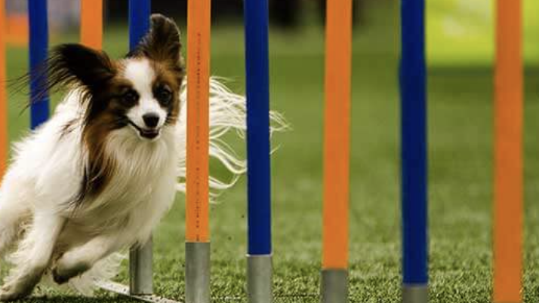
Agility Report
Lisa Nawrocki
Highlights
We had a good year of agility with so many new students and we are getting more that are interested in competing at some point which is very fun to hear.
Anitra and Laura had a great turnout for their open ring sessions. It would be good for us to offer open ring more often. We should offer both instructed and uninstructed as some people just want time to practice with their dogs.
We have a decline in students during the day classes. I believe Corrie is looking through her list of possible students looking for day classes.
Issues/Items needing attention
March AKC agility trial – I believe we have enough committee members but are always looking for anyone that wants to volunteer to help
May AKC agility trial – We may be scrambling to find a judge as I am not getting a response from the judge that was lined up. Mike Teh has offered to help me find someone or try to get the judge to respond.
  If anyone knows of anyone that would like to be on the committee or be the Trial Chair, please let me know and contact information would be great as I do not have many people’s contact information.
We have a decline in students during the day classes. I believe Corrie is looking through her list of possible students looking for day classes.
We are looking for a volunteer to assist with the Foundations 1 classes on Thursday evening.

Slide 17
Camp K9 Report
Meg Beisner
Camp K9 continues to enjoy a core of loyal clients who attend one or more times per week. We also added several new clients to the roster in 2025. Scheduling: We updated the website to include the live calendar for easier client viewing and booking of open slots for newcomers. We have upped our marketing efforts to try to increase enrollment, with Sara Brokaw putting in time to create some marketing videos. Meg Beisner also
created flyers for the building ring rooms. We welcomed two new trainers in the fall, Haley Kaltenbeutel and Magpie Scheel, both of whom are great fits for the program. Now we just need more dogs to train!
If you or anyone you know is interested in signing their dog up for Camp, please reach out to us at campk9@tcotc.com.

Slide 18
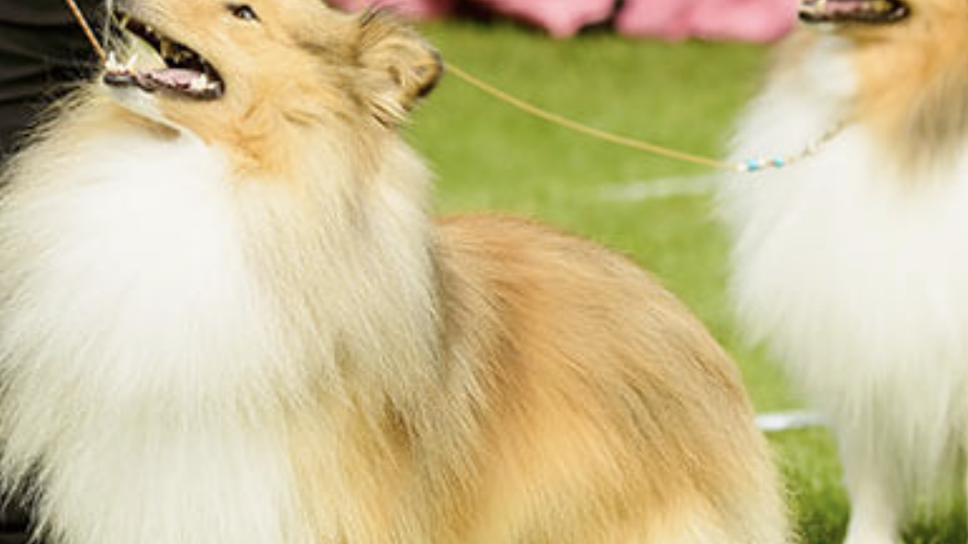
Conformation Report
Wendy Olson
AKC Conformation is one of the few sports where professionals compete against beginners and amateurs. As a result, people who believe their dog is a potential champion must learn some of the “tricks of the trade” if they want to be competitive in the show ring. Our students range from beginners to those that have been competing in the show ring for years. In addition to group instruction, each participant gets individual attention to work on their own handling skills besides teaching their dog how to properly stack and gait. Students from the class have gone on to compete in AKC, UKC and IABCA shows and have had success in finishing their dog’s championships. Several also compete in the owner handler ring besides the breed ring. Students also receive a folder of handouts I created so they have access to many of the things that are addressed in the class in written form.
In 2025, TCOTC offered two classes per week most weeks. Since I broke my shoulder and had to have a shoulder replacement, attendance was down more than normal in the first three months of the year. It is typical, however, that attendance is lower when there are no impending shows in the area. I’m grateful to Megan Schaaf who substituted for me for several weeks while I recovered. Overall, attendance was up this year, with 323 compared to 279 in 2024, and revenue of $3,578 compared to $2,646 in 2024. Possible changes in 2026 include a Junior Handlers program or beginner handler class.

Slide 19
Flyball Report
Anne Schenk
Tracking Report
Anne Schenk
In 2025 TCOTC held two Flyball 1 classes and three Flyball 2 classes, with a total of 22 members participating, an increase of 6 members over 2024. Many thanks to instructor Chris Schultz and assistants Sage Van Voorhis, Trisha Hetue, Karen Radford, Renée Foster, and Meera Kannan for making these classes available to our members this past year.
In Spring 2025 we offered three Beginner Tracking classes and one Tracking 2 class. We’re grateful to our instructors Jane Jacobson, Katina Stamp, and assistant Rhonda Noetzelman.
The fall TDX (Tracking Dog) test on Oct. 26 was cancelled due to the lack of availability of a judge. Our next test is October 24 & 25, 2026 and will be a TD. Mark your calendars as many volunteers are needed, from track layers to hospitality.

Slide 20
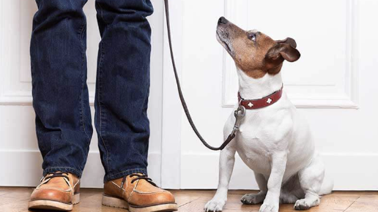
Obedience Report
Jane Jacobson
The TCOTC Obedience Department continues to train puppies and dogs from 7 weeks to any age, and any pedigree or mix thereof, three nights and one morning a week. We also continue to offer a wide variety of classes to meet the needs of our students from Basic Training to obedience competition. Classes are offered on Monday, Wednesday, and Thursday evenings, and Tuesday mornings. Evenings have 2 or 3 classes of Basic Training, with at least one class open to puppies under 10 months of age. There are at least 2 Tier 2 classes offered during any training night/day, with up to 4 offerings. Each training session has different Tier 2 offerings, and every class is offered at least 3 times per year. Every ring, including the Star Room, is used during the 7 pm class time, and 50 – 75% of rings are in use during the 5:50 and 8:15 pm class times.
Most of our students are interested in developing livable skills with their dog and building a cooperative relationship that benefits both parties. To meet that need we offer a wide range of classes such as Public Manners, Loose Leash Walking, Reliable Recall, Tricks, Sports Sampler, K9 Companion, Impulse Control, and Oh So Adolescent. For those students interested in obedience or Rally-O competition we offer a range of classes designed to build a competitive team with great skills and teamwork.
As in previous years, class registration is not consistent over the year. Some sessions fill early with wait lists for some classes and other sessions have a low or minimal number of students. The desires of students also continue to fluctuate with a particular class such as Reliable Recall filling quickly in one session while the same class offered again at a different time barely has enough students.

Slide 21
Obedience Report cont’d
Jane Jacobson
We continue to strive to improve our instruction to better meet the needs of our students, both human and canine, by staff development during staff meetings and evaluations, curriculum development and review, and feedback from students. Discussions during staff meetings included skills to reinforce the human half of the team, dealing with failure, and developing new curriculum for a Tricks 2 class, senior class, youth class, and preparing for a Fetch test.
Scentwork continues to be a very popular class following curriculum developed and taught by Sara Brokaw. Students progress through 3 levels where the dog learns to find 3 different odors by “going to source”, and the humans learn to read their dog. After the initial 3 classes students join an on-going Advanced class with more difficult hides and search scenarios. New times have been added on Thursday evening and a new time will begin on Tuesday afternoons starting in January. Assistants (Elektra Wrenholt, Anne Schenk, and Shari Gross) have been added to classes to allow for more feedback, help with set-up and tear-down, videoing, and the ability to have extra searches.
Several events were held in 2025 including 2 Game Nights for handlers and dogs to have fun and play games, a Fetch test (a program by the AKC in the Family Dog program), and our annual obedience trial in October. We also hosted a new obedience trial in February which was the Region 10 qualifying trial for the National Obedience Championship (NOC) from the AKC. Be sure to watch for ways you can support the club during another NOC qualifying trial this coming February.

Slide 22
Obedience Report cont’d
Jane Jacobson
Also starting in January is a new popular class – Treibball, also known as urban herding. This will be taught by Karen Sheahan and Heidi Thorson and follow curriculum developed by the national organization, the National Association of Treibball Enthusiasts. Due to its popularity, a random draw was held for the students wishing to be in the class.
A big thank you to my entire staff for making 2025 the best year possible: Chris Schultz, Dennis Carlson-Rioux, Donna Grabowski, Joyce Carlson-Rioux, Julie Heaton Hill, Karen Wennberg, Katina Stamp, Laura Waudby, Mary Verness, Meera Kannan, Meg Beisner, Scott McKenzie, Renee Foster, Sara Brokaw, Sherri Besaw, Trisha Hetue, Linda Lenc, Jenny Edgerton, Paul Mockovak, Elektra Wrenholt, Stephanie Nowak, Brittany Foster, Karen Sheahan, Vicky Hagens, and Merle Geode. It’s great to have you! We are also pleased that Jenny Edgerton moved into an instructor role this year.
We are always looking for great staff, both instructors and assistants. If you enjoy working with people and dogs and are committed to fostering the human/canine bond for the betterment of both, talk to Jane Jacobson or email the TCOTC office (office@tcotc.com). Also watch for an Observing Behaviors class which is the first step in becoming an assistant or instructor.

Slide 23
Therapy Dog Program Report
Carol Ouhl
ASSESSMENTS FOR ELIGIBILITY TO TAKE CLASSES
2 Assessment Events Held
2 events cancelled due to lack of registration
12 approved for class
o As always, ineligible people continue to register with dogs too young, no control, no obedience training, no idea of concept
CLASSES
3 class blocks were offered.
o 1 block of Level 1
o 1 block of Level 2
o 1 block of Hybrid Therapy Prep
Remaining 3 blocks normally offered Not scheduled
o 1 Not offered – No qualified students
o 2 Not offered – My incapacity due to injury
No classes will occur 1st quarter of 2026
ASSISTANT INSTRUCTORS
Angela Rodgers returned to assist this year
o She learned the curriculum last year to know what I needed from her and when
o She adjusted quickly when discovering my curriculum changes based on needs of students·
Nicole Herlofsky, former student, obedience instructor and accomplished therapy dog handler assisted as often as her schedule allowed
o She didn’t know the curriculum but knows all the skills needed and how to teach them
EVALUATIONS TO BECOME REGISTERED VISITING TEAM
· Attitudes about evaluations have changed over the last couple years
· Most students are opting for the easiest national organization’s tests
·Even the easiest tests are still difficult to find; but it doesn’t take quite as long to find them
THERAPY DOG VISITS
· As previously mentioned my dog is trained and could pass the most difficult therapy dog test but is inconsistent when actually working
· We did a couple demo/educational visits this year under my trainer’s insurance
OTHER SCHOOLS ARE HAVING SIMILAR DIFFICULTIES
· Other schools offer therapy dog classes sporadically
· The economy has reduced the number of people wanting / able to train and visit

Slide 24
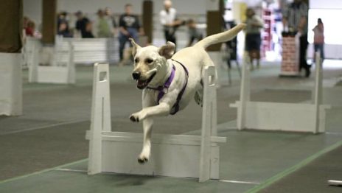
Flyball Team Report
Karen Radford
Tournament The tournament ran smoothly this year with no major issues. Participation was down over the last two years with 18 teams from 11 different clubs participating.
Due to reduced participation, our tournament finances show a decrease over last year. A price increase of $5/entry buffered the losses a bit. We are optimistic a date change in 2026 to be after CanAm will boost participation. You can find a summary of the income and expense breakdown in the table below. Further information regarding the financial details can be provided on request.
Raffle We held a raffle this year, raising an estimated $1076 for the Club. A big thank you to Lornell Brand and Roxanne Johnson for organizing the raffle, and to everyone who donated items and bought or sold tickets!
Titles Achieved 2025 was an excellent year for titles with seven active dogs earning one or more titles.
Handler Dog Breed Title
Jan Wagner Dobby Pug FM
Lynnda Lenzen Haiku Mix Onyx
Karen Radford Myg Mix FM
Roxanne Johnson Nash Mix FM
Karen Radford Nebbie Mix FMX
Lorrie Pilgrim Shelby Border Collie FMCH
Lynnda Lenzen Tuvok English Cocker FDCH-G, FM
As always, we are open to new members or those interested in exploring the sport and we look forward to more successful racing in 2025.

Slide 25
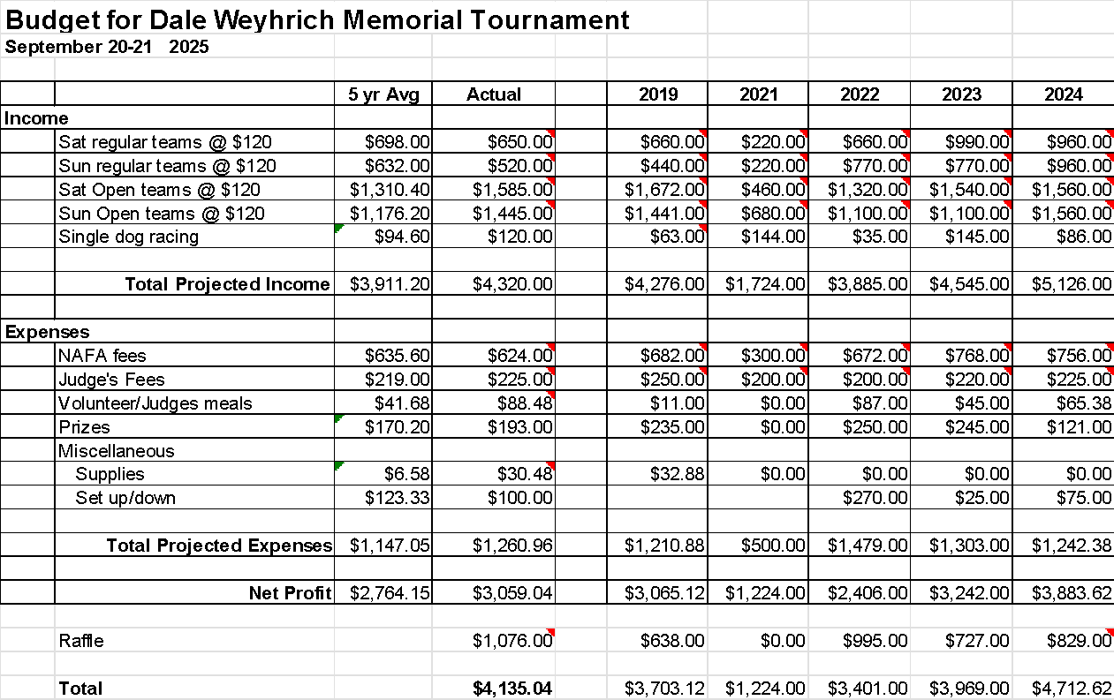
Flyball Team Report cont’d
Karen Radford

Slide 26
Marketing Committee Report
Anne Schenk
Our email outreach continues to be an important communication and marketing tool. We had a total of more than 554,135 individual sends, up from 463,914 in 2024, reaching all members and many who are non-members or past members. The vast majority of these sends are the weekly e-newsletter, while others are automated marketing messages. 357 people responded to automated requests for customer satisfaction feedback, with 88% giving a positive rating, up from 83% in 2024. 7.5 percent gave a neutral rating, and 4.5 percent gave a negative rating.
TCOTC’s online engagement grew slightly in 2025. The club’s Facebook followers increased from 4,191 to 4,320 and continues to be a key method of communicating with our audience. Our Instagram account has grown from 631 to 660 followers. Our YouTube channel went from 366 to 390 subscribers and is mostly used for live streaming agility trials. We added TikTok to our social media presence and have a volunteer who is creating content for TikTok and other social media accounts.
We continued our participation at the State Fair, holding demonstrations in agility, obedience, and conformation. We enjoyed great volunteer participation this year and we are grateful to the Minnesota Purebred Dog Breeders Association for allowing us to participate.

Slide 27
Building Committee Report
Karen Radford
Building Committee Purpose
Current members include Joyce Carlson-Rioux, Amy Pirkl and Karen Radford with assistance from Anne Schenk. With the decision made to remain in our current facility, the committee was tasked with evaluating the building to determine what updates or improvements could enhance its appearance, functionality, and overall member experience.
The committee's 2025 objective included:
Identifying, reviewing, and prioritizing potential facility upgrades
Confirming the cost and feasibility of these upgrades
Identifying any improvements that may need to be incorporated into long-term lease negotiations
Actions Completed or In Process - the following actions have been completed or are currently underway:
Implemented actions from energy audit
  Investigated available utility rebates
  Completed lighting upgrade
Updated kitchen electrical service
Determined that no major capital items are required for lease evaluation
Installed donated fans in ring room
Tested and evaluated purchased hearing-assist devices

Slide 28
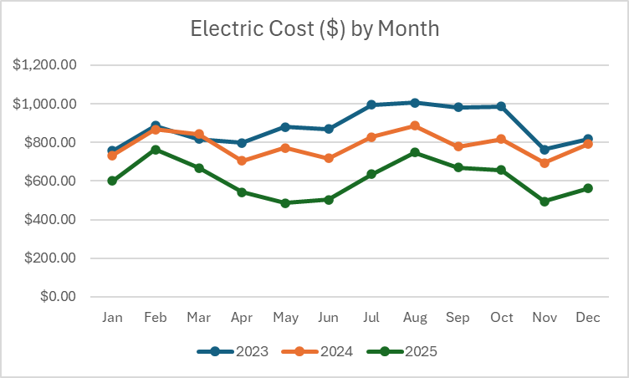
Building Committee Report cont’d
Karen Radford
Built tall barriers to assess visual-distraction mitigation
Conducted sound mitigation evaluation and developed a proposal
Painted poles in preparation for the February Obedience trial
Reviewed member survey feedback for additional building-related input
Install cover on fan louvers
Investigate garage door insulation
Going Forward - the team accomplished a significant amount this year and made strong progress on our to-do list. Looking ahead, we are finding that further upgrades are increasingly limited by both cost and the level of participation needed to complete certain evaluations. As a result, meetings and activities of the Building Committee will be paused until the Board provides additional strategic direction.

Slide 29

Lease Negotiation Task Force
Maddie O’Rourke, TCOTC Treasurer
New Lease Issue: Rent would include paying building insurance. ($11,000 annually)

Slide 30

Issues with New Lease
Property taxes are variable and have more than doubled in the past decade.
Building insurance is expensive and goes up about 10% per year.
We operate at margin or in some years below margin and therefore cannot afford an extra $11,000 in building insurance annually.
Based on our projected revenue and expenses, we would not be able to afford rent in the next ten years.

Slide 31
Final Lease Agreement
Past Leases
Final Lease
Lease term is for ten years
Rent was about $97,000 per year with increases every year
Property Taxes $97,000 annually
We paid $0 for building insurance annually
Lease term is for five years
Lowered rent to $82,000 per year with increases every two years.
Property Taxes lowered to $82,000 annually.
We will pay $11,000 for building insurance annually

Slide 32



Thank you to fellow task force members Jan Wagner and June Mendoza. Thank you to the TCOTC Finance Committee and Board for your input and suggestions.
We got a great deal! The amount we are paying is way under market value.
Capp our landlord values us as a tenant and is willing to work with us.
Capp would like to know ahead of time if we are facing financial issues and feel that we may not be able to afford rent.

Slide 33
Safety Committee Report
Joyce Carlson-Rioux
In 2025 the TCOTC Safety Committee met to review the following concerns:
Grilling policy and assessment of the need for smoke detectors in kitchen. Result: Smoke Detectors have been installed in the kitchen.
Fire Extinguisher Inspection & Service: All fire extinguishers in the building were inspected and serviced as needed in 2025 by our outside contractor.
First Aid Kit readiness. Result: Julie Heaton-Hill has been restocking the First Aid Kit.
Police Drive-By during Special Events. Result: Jan Wagner contacted the Minneapolis Police Department and requested more frequent drive-by assistance
Red Cross Ready Update. This needs further attention: TCOTC is currently due for a review of the TCOTC Red Cross Ready documents.
Thank you to the following members who have served on the Safety Committee and/or helped with Safety Committee work during 2025: Jan Wagner, Anne Schenk, Julie Heaton-Hill, and Melissa Nyg.

Slide 34
Finance Committee Report
Karen Radford
The Finance Committee continued its work in 2025 with members Liz Danielson, Charlie Leavitt, Maddie O’Rourke, Julie Steenerson, Karen Radford, Anne Schenk, and Mary Steinbauer. We also worked closely with the lease-negotiation team of Maddie O’Rourke, June Mendoza, and Jan Wagner.
While the long-term goal of the committee is to focus on strategic financial planning, a number of urgent and immediate needs required significant attention this year. Much of our time was devoted to the first several items listed below, though we were able to make progress in other areas as well.
1. Policies & Compensation
Completed evaluation of the legal and tax implications of in-kind payments
Identified and reviewed options to replace the existing reward system
Finalized and implemented an updated fringe benefits policy
2. Financial Oversight & Planning
Completed financial review related to lease negotiations
Evaluated financial statements, budget, and forecast
Reviewed financial performance against the 2025 budget
Conducted budget planning for 2026

Slide 35
Finance Committee Report cont’d
Karen Radford
3. Business & Operational Development
Explored business opportunities
4. Revenue Generation Initiatives
Facilitated a Board brainstorming session focused on revenue growth
Maximizing trial income
Evaluating rental rates
Incentives to encourage class sign-ups
Exploring alternate offerings, activities, and events
Future Plans
The committee was originally formed to address significant financial concerns that required immediate attention. While not all risks have been eliminated, we have implemented several changes and encouraged culture shifts that have put the organization on a stronger financial path.
Although Mary and Anne have found the committee’s financial expertise extremely valuable, the ongoing strategic need for a committee operating at this level of intensity is uncertain. The group recommends suspending Finance Committee activities until the Board completes its strategic planning for 2026 and determines where committee resources are most needed.
No additional Finance Committee meetings are planned at this time, and the committee may be re-formed at the discretion of the Board.

Slide 36
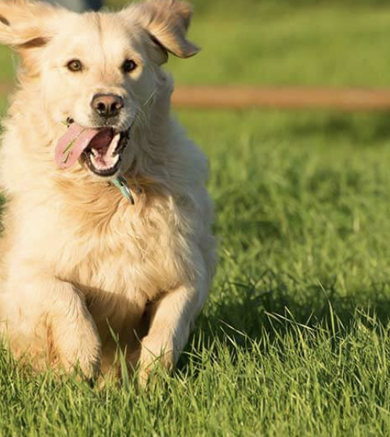
Financial Summary

Slide 37
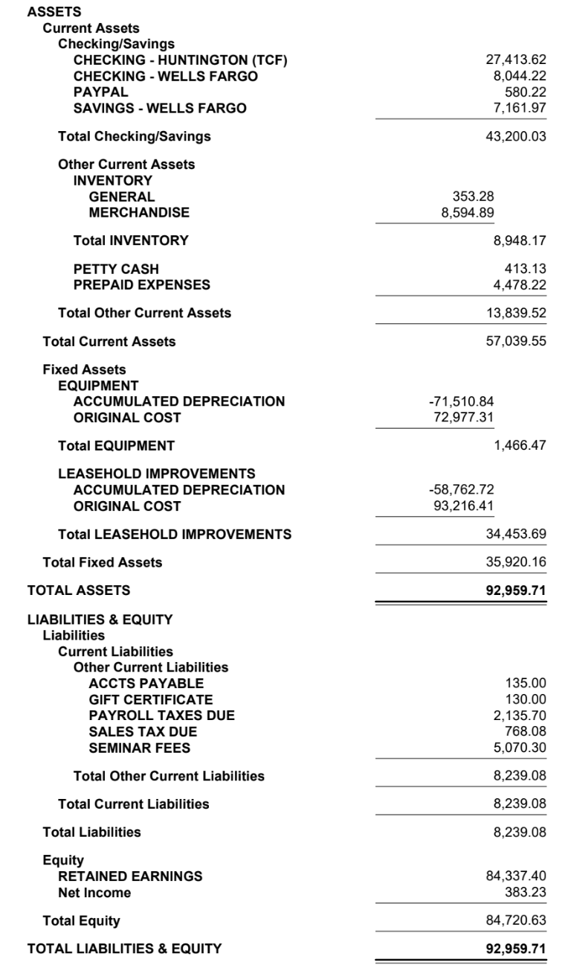
Balance Sheet
12/31/25
Prepared by Mary Steinbauer

Slide 38
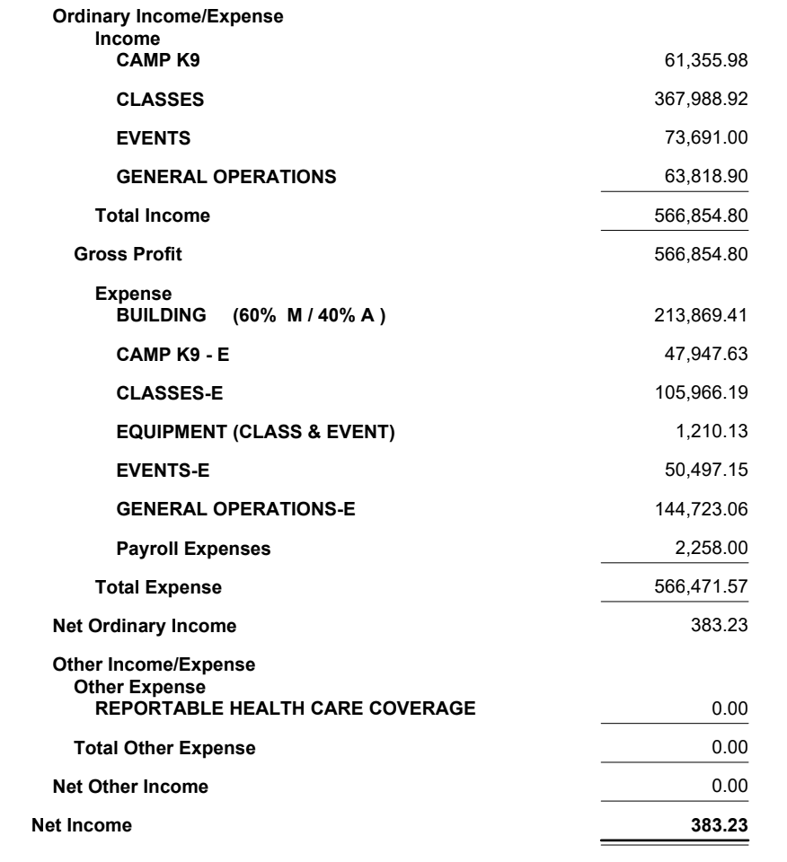
Income Statement
Year-End 2025
Prepared by Mary Steinbauer

Slide 39
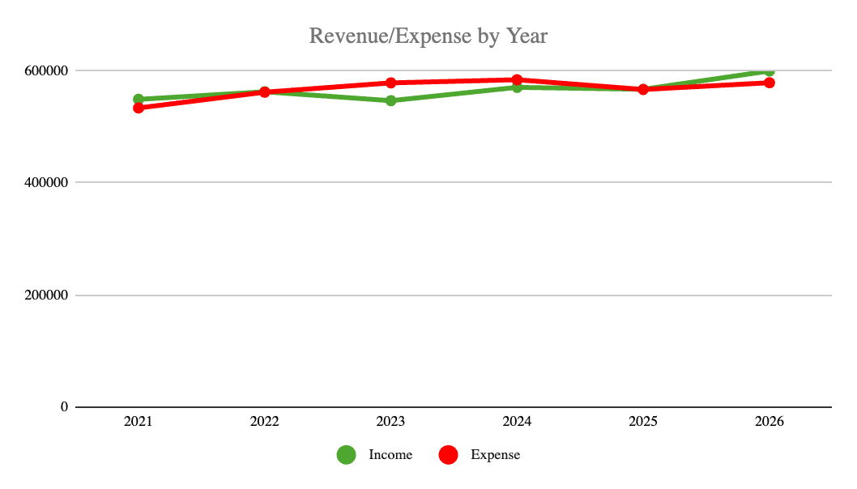
Revenue and Expenses

Slide 40
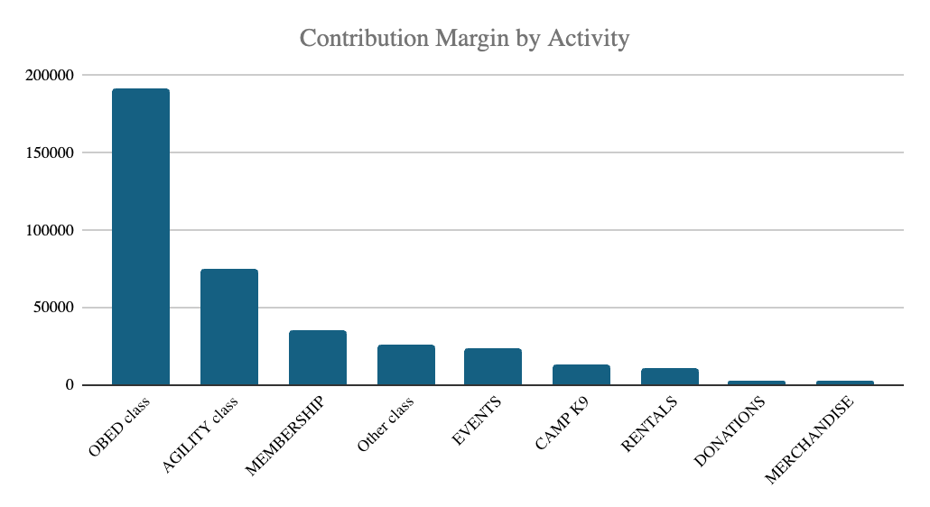
Contribution Margin = Revenue - Direct Expenses

Slide 41
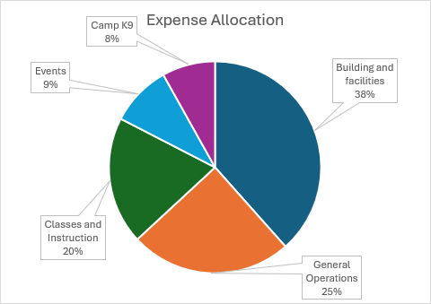
Expense Allocation

Slide 42
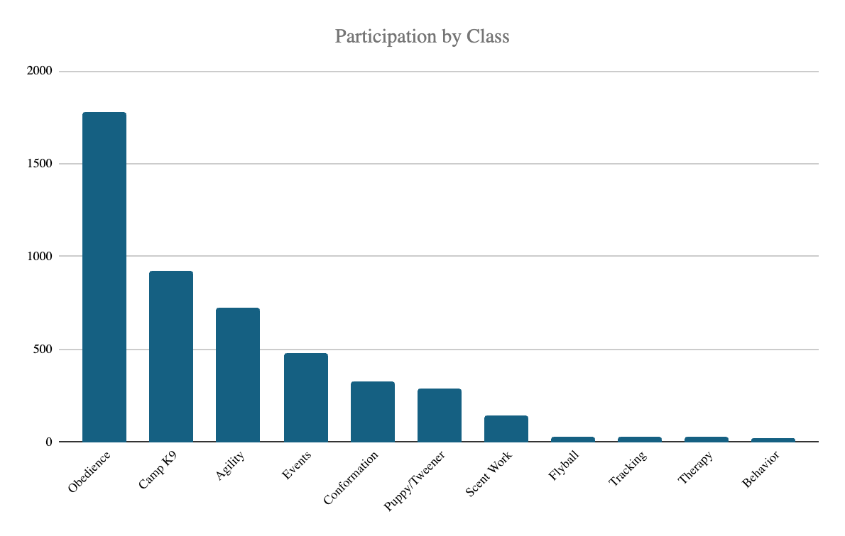
Participation by Class

Slide 43
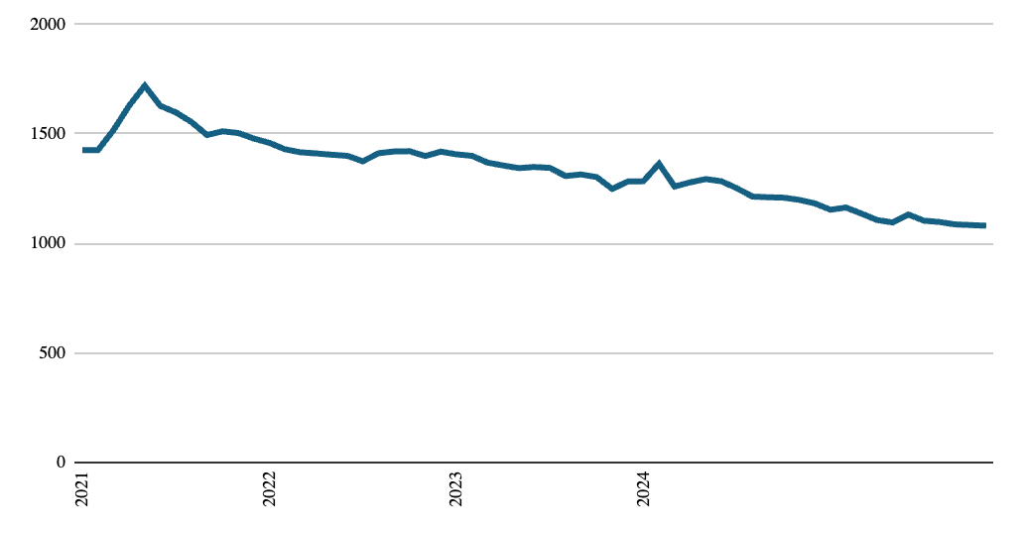
Membership - 5-yr Trend

Slide 44
2025 Actions Taken
2026 Planning
Negotiated and renewed Lease
Implemented free lighting upgrade
Developed in-house trial secretary team
Solicited revenue generating ideas
Expanded curriculum and implemented new events
Revisit Strategic Plan - possible activities:
  Re-engage Finance Committee to realign priorities
  Increase Membership Outreach and Engagement
  Implement additional revenue generating ideas
Continuous improvement
****Adjust 2027 Annual Membership Meeting to January 26

Slide 45
Election Results:
Announcement of New Board Members
2026 TCOTC Board Meetings
1/27/2026
3/10/2026
5/12/2026
Off June and July
8/11/2026
10/13/2026
12/8/2026

Slide 46
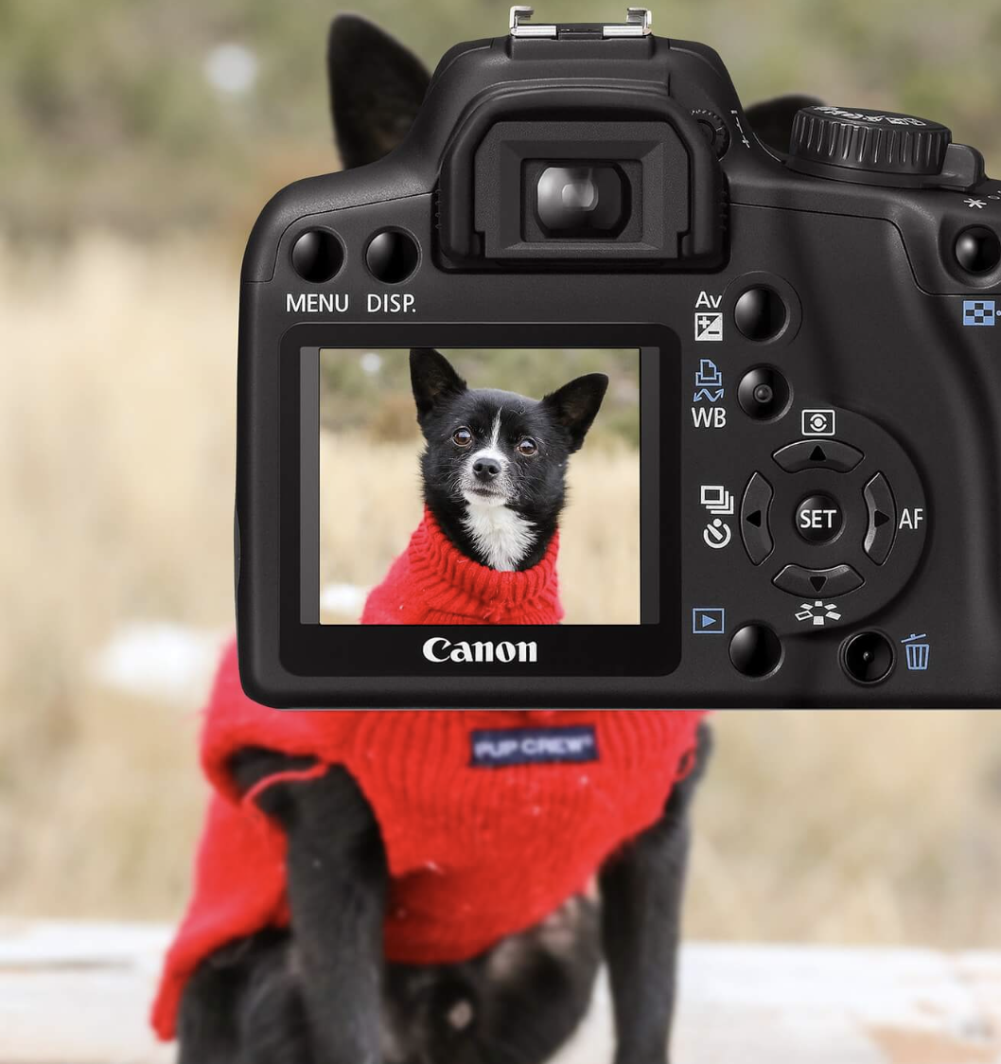
2025 Volunteer of the Year

Slide 47
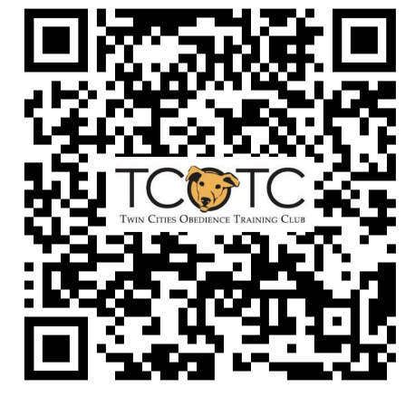
Call to Action
Volunteer!
Contact anneschenk@tcotc.com
Donate to Friends of TCOTC!
Scan to Donate

